Slide 1

How to make a cheesecake
3rd Grade 2016
Saint George’s College
Mr Max and Miss Fernanda ☺

Slide 2
Nutella cheesecake recipe
Ingredients
  250g Niza biscuits
  1/3 cup (80g) unsalted butter, softened
  3/4 cup toasted hazelnuts
  1 small jar (400g) Nutella
  500g cream cheese
  1/2 cup (80g) icing sugar

Slide 3
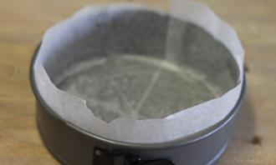
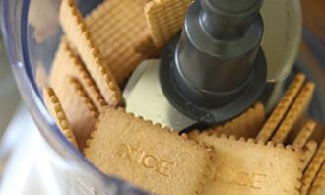
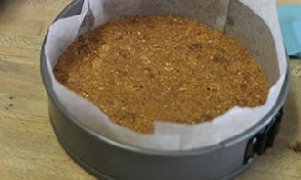
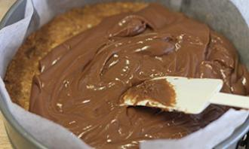
Nutella cheesecake recipe
Directions
1
1. Line a 23cm round spring form pan with baking paper and set aside.
2
2. In a food processor place the biscuits and pulse a few times to make a rough crumb. Add the butter into the bowl, 1/3 cup of the toasted hazelnuts and 1 tbsp of Nutella. Mix them well.
3
3. Press crumb onto the pan and flatten using the base of a glass. Chill while making the topping.
4
4. Stir the softened cream cheese with the remaining Nutella and icing sugar until well combined. Pour over chilled base and smooth top. Sprinkle remaining toasted hazelnuts over the top and chill for 3-4 hours. Serve straight from the fridge.

Slide 4

Complete the questions
Open your notebooks, please! ☺
MUCH
MANY
or
How many bags of Niza biscuits do you need?
How much butter do you need?
How many jars of Nutella do you need?
How much cream cheese do you need?
How much sugar do you need?
How ___________ bags of Niza biscuits do you need?
How ___________ butter do you need?
How ___________ jars of Nutella do you need?
How ___________ cream cheese do you need?
How ___________ sugar do you need?

Slide 5
Answer the questions
Ingredients
  2 bags of Niza biscuits
  1/3 cup (80g) unsalted butter, softened
  3/4 cup toasted hazelnuts
  1 small jar (400g) Nutella
  500g cream cheese
  1/2 cup (80g) icing sugar
1. How many bags of Niza biscuits do you need?
a) 1 bag of Niza biscuits.
b) 2 bags of Niza biscuits.
c) 3 bags of Niza biscuits.
2. How much butter do you need?
a) 1/4 cup
b) 1/2 cup
c) 1/3 cup
3. How many jars of Nutella do you need?
a) 1 big jar
b) 1 small jar
c) 5 jars

Slide 6
Sequence the steps
______ In a food processor place the biscuits and pulse a few times to make a rough crumb.
______ Sprinkle remaining toasted hazelnuts over the top.
______ Line a 23cm round spring form pan with baking paper and set aside.
______ Stir the softened cream cheese with the remaining Nutella and icing sugar.

Slide 7
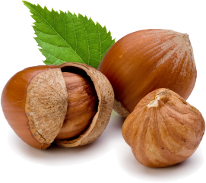
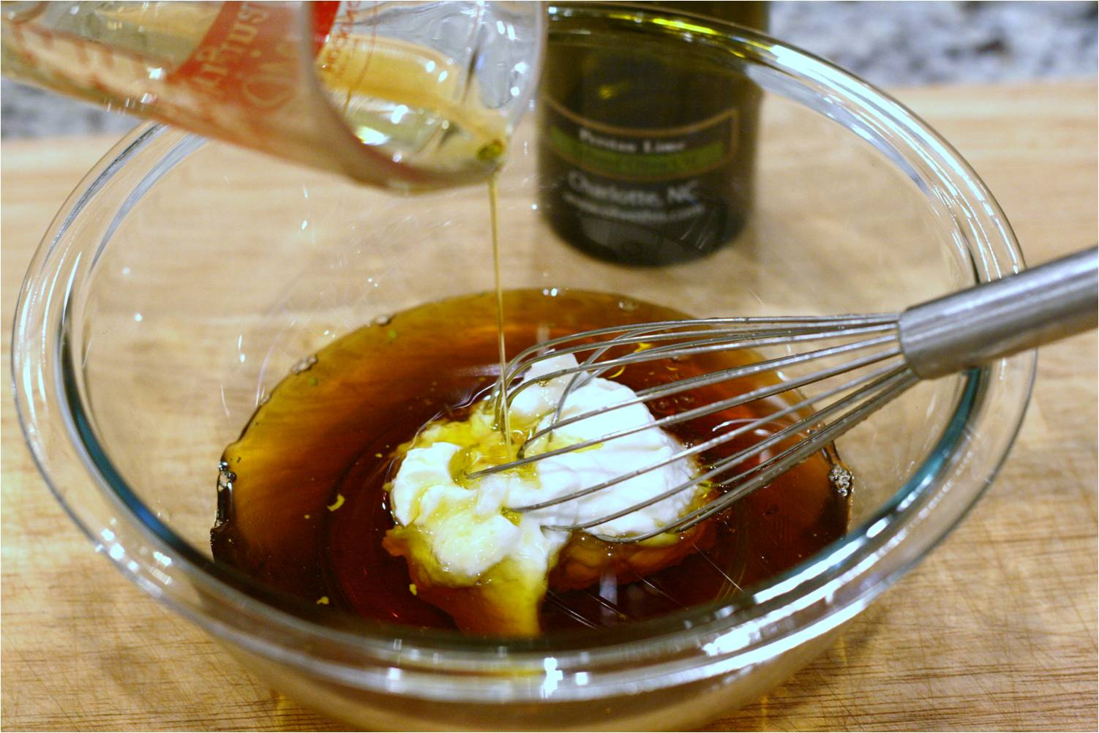
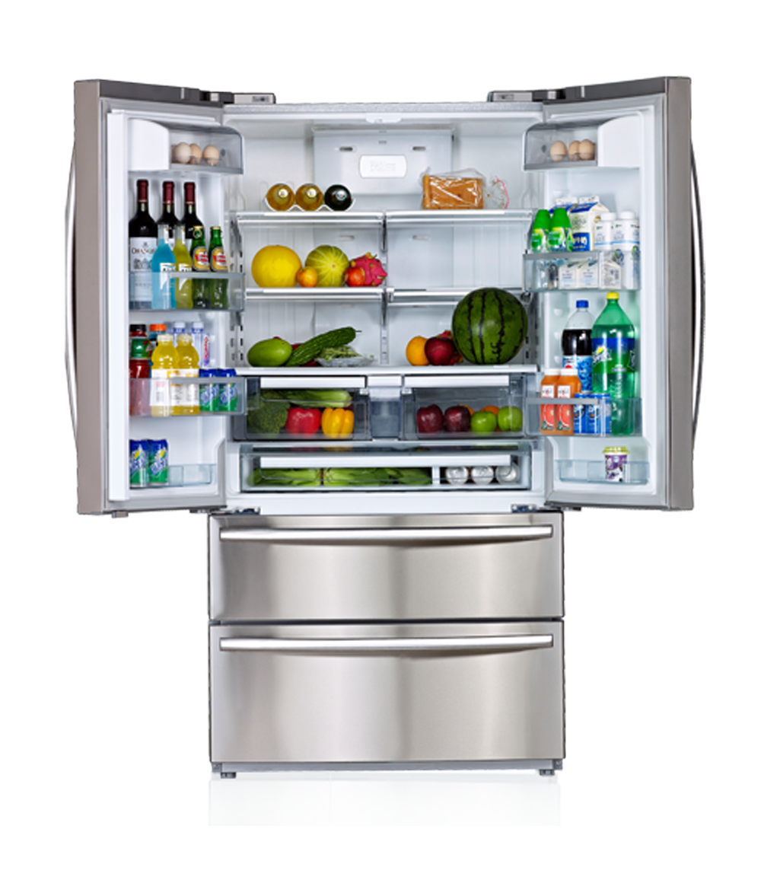

What would happen if…
1 … the ingredients don’t combine?
2 … the fridge doesn’t work?
3 … you don’t have hazelnuts?

